Slide 1

Web Development Essentials: HTML, CSS, & JavaScript
Presented by A. Deepika 24524U18019
Karan Arts and Science College, Thiruvannamalai

Slide 2
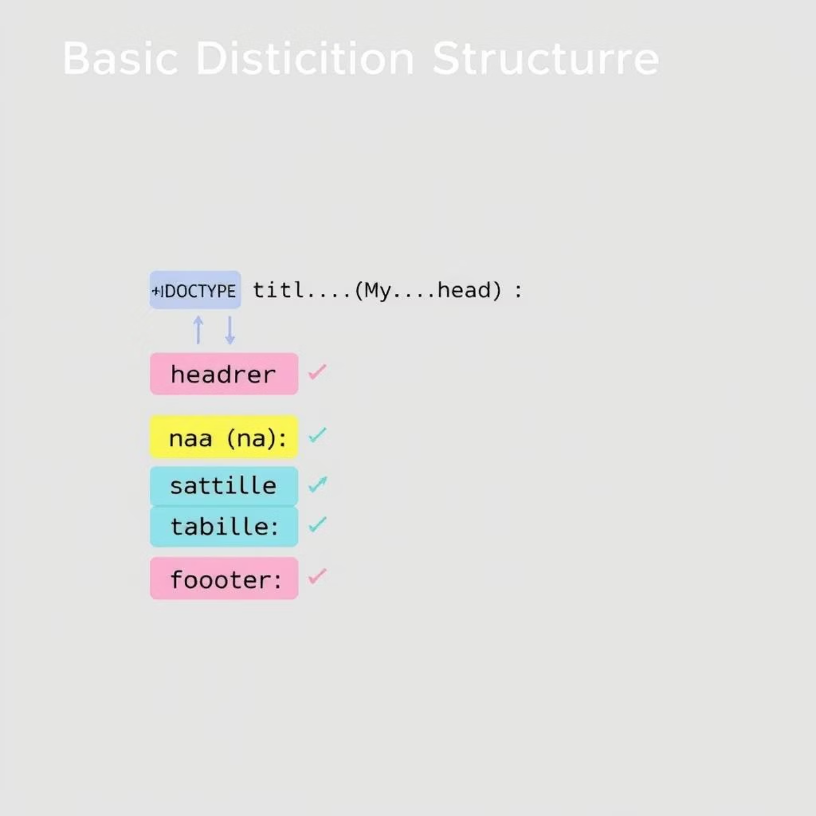
The Blueprint: Structuring Content with HTML5
HTML, or HyperText Markup Language, serves as the fundamental blueprint for all web pages. It defines the structure and content of a website, using a system of tags to organize elements like headings, paragraphs, images, and links.
HTML5, the latest version, introduced powerful semantic elements like <header>, <nav>, <article>, and <footer>, improving accessibility and search engine optimization. These elements give meaning to the content, making it easier for both browsers and developers to understand the page's layout and purpose.

Slide 3

The Designer: Styling Pages with CSS3
CSS, or Cascading Style Sheets, is the language used to style the look and feel of a web page. While HTML provides the structure, CSS adds the visual flair, transforming plain content into a visually engaging experience. With CSS, designers control colors, fonts, spacing, layouts, and animations.
Aesthetics & Branding
Responsive Design
Defines colors, typography, and visual hierarchy to match branding guidelines and enhance readability.
Enables websites to adapt seamlessly to different screen sizes and devices, from desktops to mobile phones, ensuring optimal user experience.
Layout & Spacing
Manages the positioning and arrangement of elements on the page, creating visually appealing and functional layouts.

Slide 4




The Enabler: Adding Interactivity with JavaScript
JavaScript (JS) brings web pages to life by enabling dynamic and interactive behavior. It allows developers to create engaging user experiences, from simple animations to complex web applications. JS interacts with HTML and CSS to modify content, respond to user actions, and communicate with servers.
Event Handling
DOM Manipulation
Responds to user interactions like clicks, hovers, and keyboard inputs, triggering specific actions.
Dynamically changes the content, structure, and style of HTML elements on the fly, without needing a full page reload.
Asynchronous Operations
Fetches data from servers in the background, updating parts of the page without disrupting the user's flow.

Slide 5
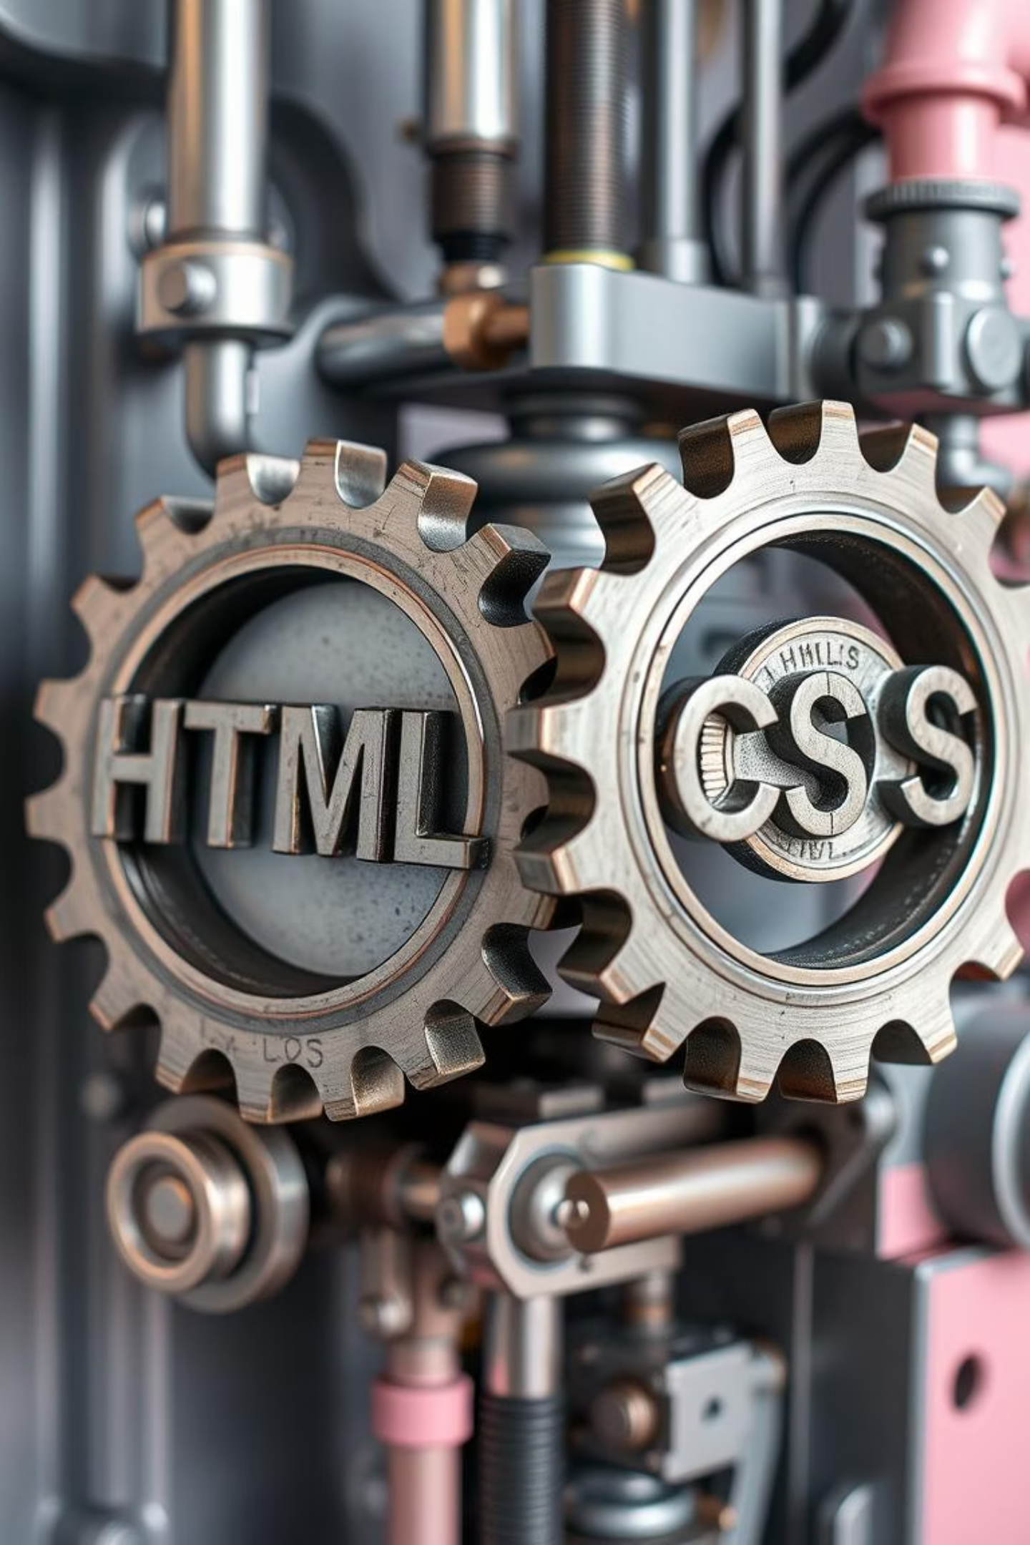


The Dynamic Duo: How HTML & CSS Collaborate
HTML and CSS are inherently intertwined, forming the visual foundation of the web. HTML provides the raw content and semantic structure, while CSS dictates how that content is presented and styled.
HTML: Structure
Defines the content and its organization.
CSS: Style
This separation of concerns is a core principle in web development. It makes websites more maintainable, scalable, and easier to update. Imagine building a house: HTML is the frame, walls, and rooms, and CSS is the interior design, paint, and furnishings.
Applies visual presentation to the structure.

Slide 6






The Power Trio: JavaScript Elevating User Experience
When HTML, CSS, and JavaScript work together, they unlock the full potential of modern web development. This powerful trio creates rich, interactive, and highly responsive web applications that feel intuitive and engaging to users.
CSS
Visual Styling
HTML
Content Structure
JavaScript
Dynamic Interactivity
From dynamic forms that validate input in real-time to interactive maps, animations, and data visualizations, JavaScript enhances the user experience by bringing life to the static structure of HTML and the aesthetic design of CSS.

Slide 7
From Static to Dynamic: Client-Side Rendering with JS
Traditional web pages were largely static, meaning the server sent a complete HTML file for each page requested. With JavaScript, client-side rendering became prominent, allowing web applications to load content dynamically in the user's browser, leading to faster, more fluid experiences.
Static Pages (HTML/CSS)
Single-Page Applications (SPAs)
Server sends full HTML, limited interactivity.
JS renders most content client-side, smooth transitions.
1
2
3
4
AJAX Introduction
Modern Frameworks
JS fetches small data chunks without full reloads.
React, Angular, Vue streamline complex client-side development.
This evolution enables the creation of rich Single-Page Applications (SPAs) where users navigate without constant page reloads, offering a seamless experience akin to desktop applications. JavaScript frameworks and libraries like React, Angular, and Vue.js have popularized this approach.

Slide 8





Essential Developer Tools for Web Pros
Modern web development relies on a robust ecosystem of tools that enhance productivity, streamline workflows, and facilitate debugging. Mastering these tools is crucial for any aspiring web professional.
Code Editors (IDE)
Visual Studio Code, Sublime Text, provide advanced features like syntax highlighting, autocompletion, and integrated terminals.
Browser Developer Tools
Built-in tools in Chrome, Firefox, etc., for inspecting HTML/CSS, debugging JavaScript, and monitoring network requests.
Version Control (Git)
Manages code changes, facilitates collaboration, and allows developers to revert to previous versions of their project.
Package Managers (NPM/Yarn)
Manages and installs project dependencies (libraries, frameworks, tools) efficiently.

Slide 9
Best Practices for Clean & Maintainable Code
Writing clean, well-structured, and maintainable code is as important as writing functional code. It ensures long-term project health, easier collaboration, and efficient debugging.
Readability & Consistency
Modularity & Reusability
Use consistent naming conventions, clear comments, and proper indentation. Write self-documenting code that is easy to understand for others (and your future self).
Break down code into small, focused functions and components. This promotes reusability, reduces redundancy, and makes testing easier.
Performance Optimization
Testing & Debugging
Optimize images, minimize HTTP requests, and write efficient JavaScript to ensure fast loading times and a smooth user experience.
Implement unit and integration tests. Utilize browser developer tools and logging to identify and fix issues effectively, preventing bugs in production.

Slide 10
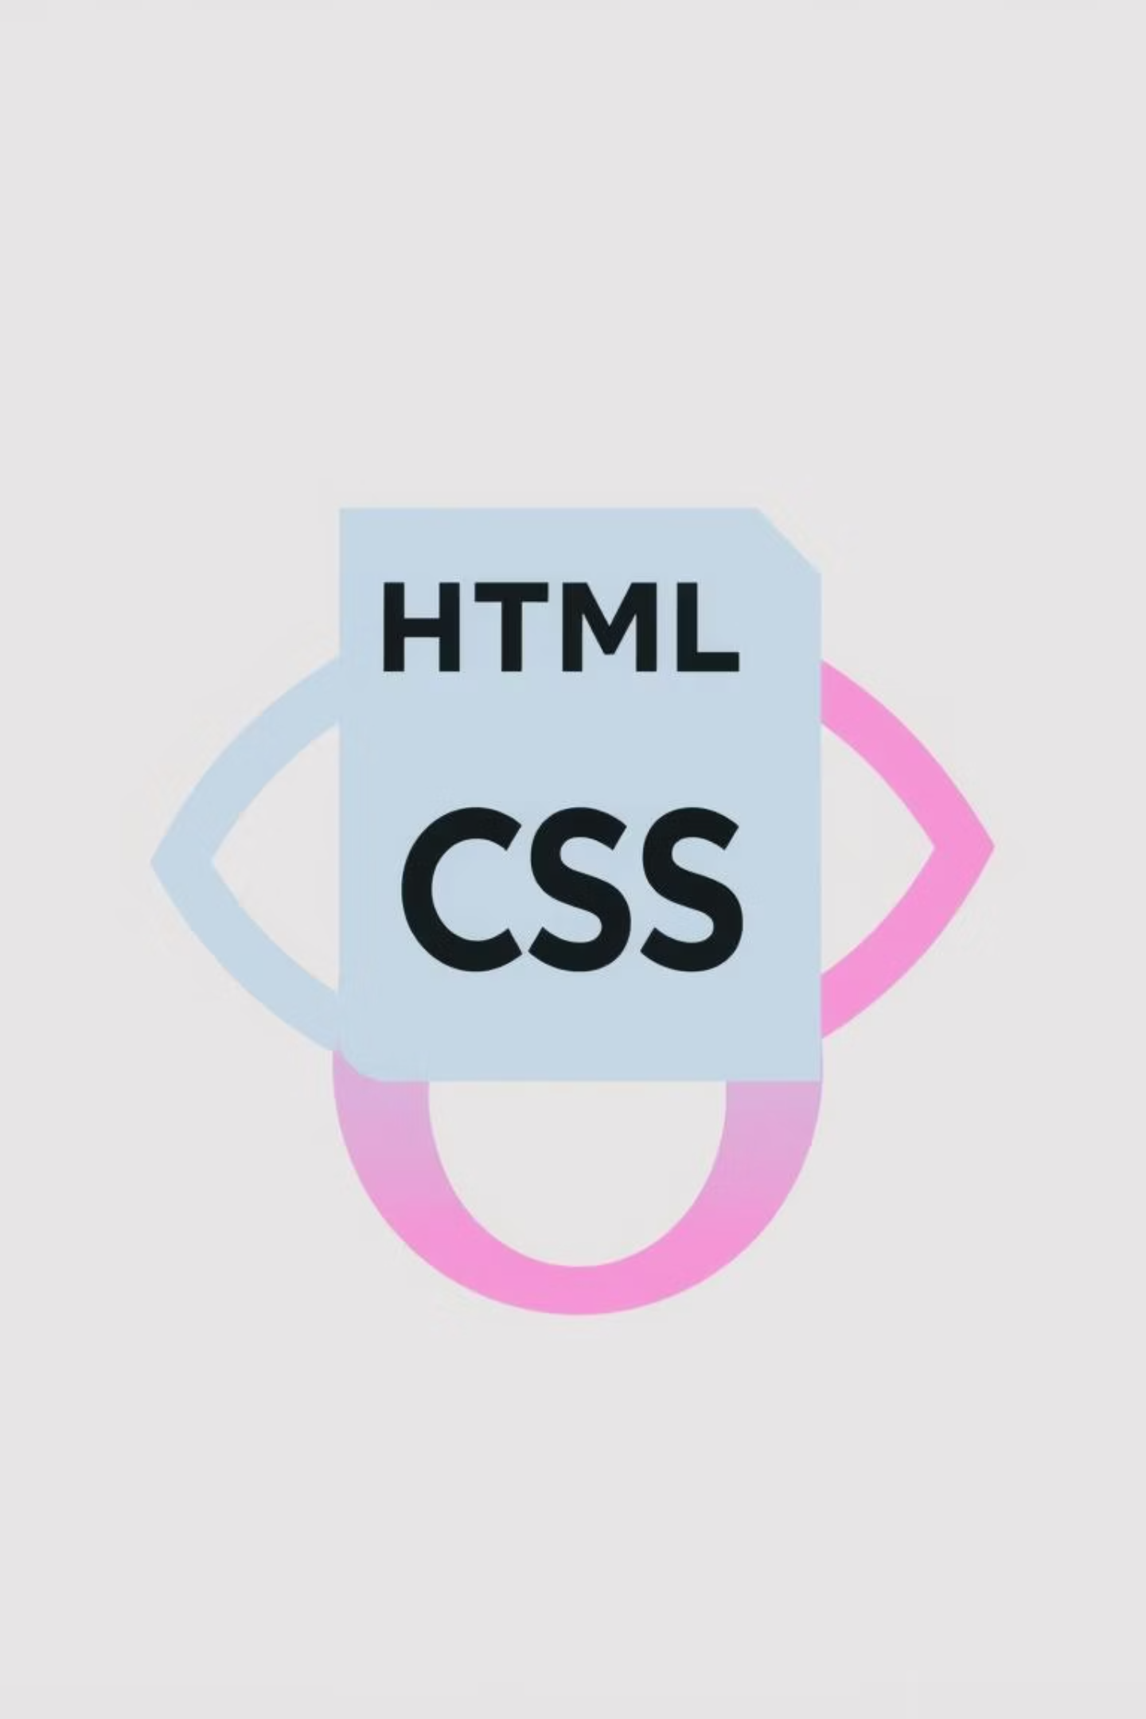
Thank You!
The journey into web development begins with these foundational pillars. HTML, CSS, and JavaScript are your essential tools to build, style, and bring the digital world to life.
Continue exploring, building, and innovating!

